Slide 1
Rukmini Devi’s love letter!
SRIMAD
BHAGAVATAM
10.52.37 - 43

Slide 2
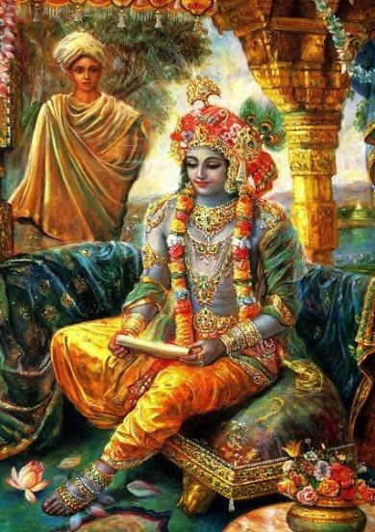
RUKMINI DEVI’S PRAYERS
SRIMAD BHAGAVATAM 10.52.37
श्रीरुक्‍मिण्युवाच श्रुत्वा गुणान् भुवनसुन्दर श‍ृण्वतां ते निर्विश्य कर्णविवरैर्हरतोऽङ्गतापम् । रूपं द‍ृशां द‍ृशिमतामखिलार्थलाभं त्वय्यच्युताविशति चित्तमपत्रपं मे ॥ ३७ ॥
śrī-rukmiṇy uvāca śrutvā guṇān bhuvana-sundara śṛṇvatāṁ te nirviśya karṇa-vivarair harato ’ṅga-tāpam rūpaṁ dṛśāṁ dṛśimatām akhilārtha-lābhaṁ tvayy acyutāviśati cittam apatrapaṁ me
Śrī Rukmiṇī said [in her letter, as read by the brāhmaṇa]: O beauty of the worlds, having heard of Your qualities, which enter the ears of those who hear and remove their bodily distress, and having also heard of Your beauty, which fulfills all the visual desires of those who see, I have fixed my shameless mind upon You, O Kṛṣṇa.

Slide 3
RUKMINI DEVI’S PRAYERS
SRIMAD BHAGAVATAM 10.52.38
श्रीरुक्‍मिण्युवाच का त्वा मुकुन्द महती कुलशीलरूप- विद्यावयोद्रविणधामभिरात्मतुल्यम् । धीरा पतिं कुलवती न वृणीत कन्या काले नृसिंह नरलोकमनोऽभिरामम् ॥ ३८ ॥
kā tvā mukunda mahatī kula-śīla-rūpa- vidyā-vayo-draviṇa-dhāmabhir ātma-tulyam dhīrā patiṁ kulavatī na vṛṇīta kanyā kāle nṛ-siṁha nara-loka-mano-’bhirāmam
Śrī Rukmiṇī said [in her letter, as read by the brāhmaṇa]: O Mukunda, You are equal only to Yourself in lineage, character, beauty, knowledge, youthfulness, wealth and influence. O lion among men, You delight the minds of all mankind. What aristocratic, sober-minded and marriageable girl of a good family would not choose You as her husband when the proper time has come?

Slide 4
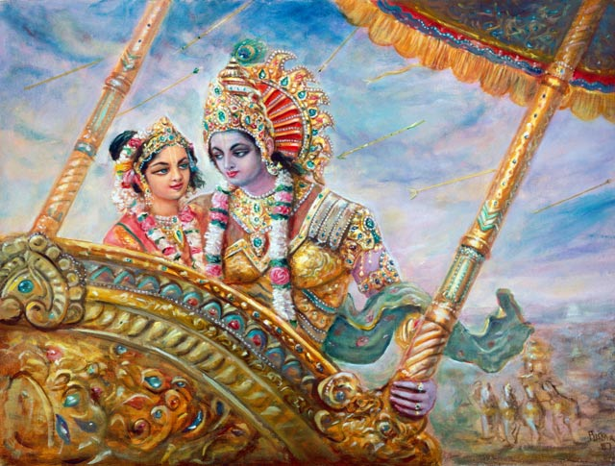
RUKMINI DEVI’S PRAYERS
SRIMAD BHAGAVATAM 10.52.39
श्रीरुक्‍मिण्युवाच
तन्मे भवान् खलु वृत: पतिरङ्ग जाया- मात्मार्पितश्च भवतोऽत्र विभो विधेहि । मा वीरभागमभिमर्शतु चैद्य आराद् गोमायुवन्मृगपतेर्बलिमम्बुजाक्ष ॥ ३९ ॥
tan me bhavān khalu vṛtaḥ patir aṅga jāyām ātmārpitaś ca bhavato ’tra vibho vidhehi mā vīra-bhāgam abhimarśatu caidya ārād gomāyu-van mṛga-pater balim ambujākṣa
Śrī Rukmiṇī said [in her letter, as read by the brāhmaṇa]: Therefore, my dear Lord, I have chosen You as my husband, and I surrender myself to You. Please come swiftly, O almighty one, and make me Your wife. My dear lotus-eyed Lord, let Śiśupāla never touch the hero’s portion like a jackal stealing the property of a lion.

Slide 5
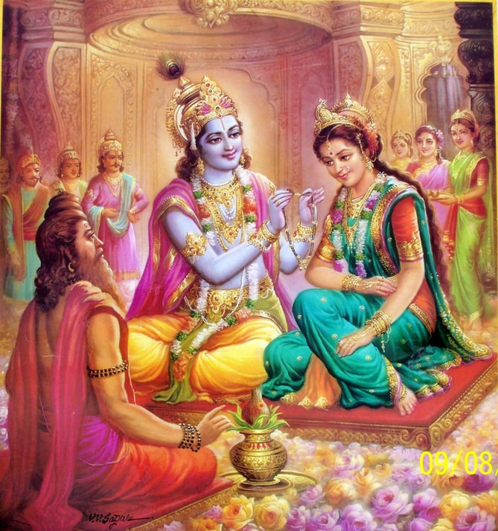
RUKMINI DEVI’S PRAYERS
SRIMAD BHAGAVATAM 10.52.40
श्रीरुक्‍मिण्युवाच
पूर्तेष्टदत्तनियमव्रतदेवविप्र- गुर्वर्चनादिभिरलं भगवान् परेश: । आराधितो यदि गदाग्रज एत्य पाणिं गृह्णातु मे न दमघोषसुतादयोऽन्ये ॥ ४० ॥
pūrteṣṭa-datta-niyama-vrata-deva-vipra gurv-arcanādibhir alaṁ bhagavān pareśaḥ ārādhito yadi gadāgraja etya pāṇiṁ gṛhṇātu me na damaghoṣa-sutādayo ’nye
Śrī Rukmiṇī said [in her letter, as read by the brāhmaṇa]: If I have sufficiently worshiped the Supreme Personality of Godhead by pious works, sacrifices, charity, rituals and vows, and also by worshiping the demigods, brāhmaṇas and gurus, then may Gadāgraja come and take my hand, and not Damaghoṣa’s son or anyone else.

Slide 6
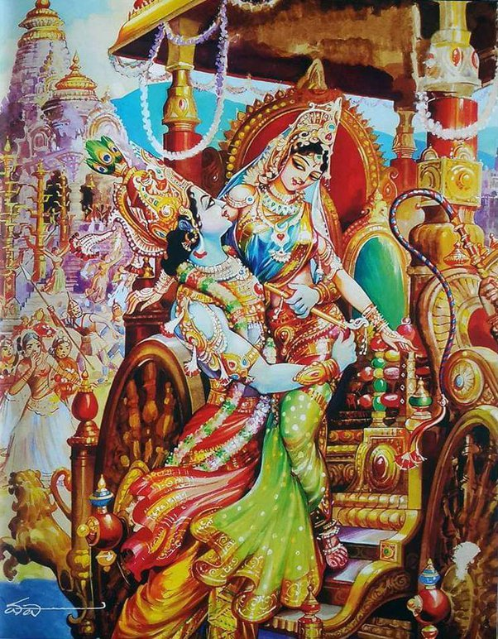
RUKMINI DEVI’S PRAYERS
SRIMAD BHAGAVATAM 10.52.41
श्रीरुक्‍मिण्युवाच
श्वोभाविनि त्वमजितोद्वहने विदर्भान् गुप्त: समेत्य पृतनापतिभि: परीत: । निर्मथ्य चैद्यमगधेन्द्रबलं प्रसह्य मां राक्षसेन विधिनोद्वह वीर्यशुल्काम् ॥ ४१ ॥
śvo bhāvini tvam ajitodvahane vidarbhān guptaḥ sametya pṛtanā-patibhiḥ parītaḥ nirmathya caidya-magadhendra-balaṁ prasahya māṁ rākṣasena vidhinodvaha vīrya-śulkām
Śrī Rukmiṇī said [in her letter, as read by the brāhmaṇa]: O unconquerable one, tomorrow when my marriage ceremony is about to begin, You should arrive unseen in Vidarbha and surround Yourself with the leaders of Your army. Then crush the forces of Caidya and Magadhendra and marry me in the Rākṣasa style, winning me with Your valor.

Slide 7
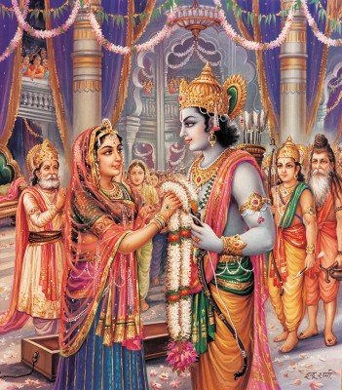
RUKMINI DEVI’S PRAYERS
SRIMAD BHAGAVATAM 10.52.42
श्रीरुक्‍मिण्युवाच
अन्त:पुरान्तरचरीमनिहत्य बन्धून्- त्वामुद्वहे कथमिति प्रवदाम्युपायम् । पूर्वेद्युरस्ति महती कुलदेवयात्रा यस्यां बहिर्नववधूर्गिरिजामुपेयात् ॥ ४२ ॥
antaḥ-purāntara-carīm anihatya bandhūn tvām udvahe katham iti pravadāmy upāyam pūrve-dyur asti mahatī kula-deva-yātrā yasyāṁ bahir nava-vadhūr girijām upeyāt
Śrī Rukmiṇī said [in her letter, as read by the brāhmaṇa]: Since I will be staying within the inner chambers of the palace, You may wonder, “How can I carry you away without killing some of your relatives?” But I shall tell You a way: On the day before the marriage there is a grand procession to honor the royal family’s deity, and in this procession the new bride goes outside the city to visit Goddess Girijā.

Slide 8
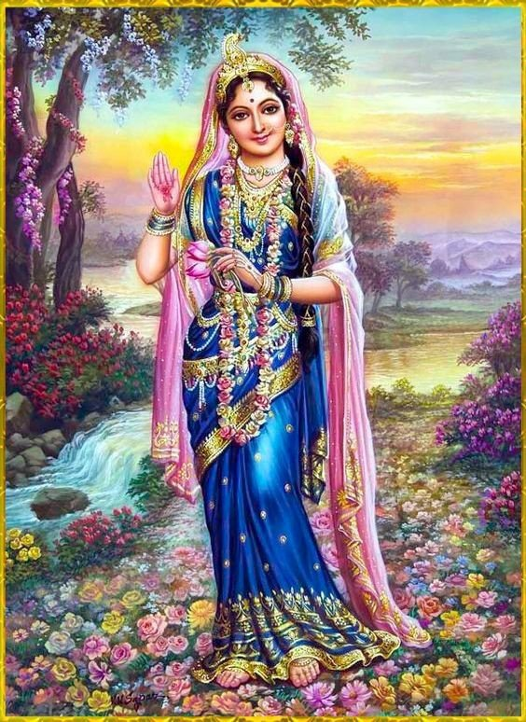
RUKMINI DEVI’S PRAYERS
SRIMAD BHAGAVATAM 10.52.43
श्रीरुक्‍मिण्युवाच
यस्याङ्‍‍घ्रिपङ्कजरज:स्‍नपनं महान्तो वाञ्छन्त्युमापतिरिवात्मतमोऽपहत्यै । यर्ह्यम्बुजाक्ष न लभेय भवत्प्रसादं जह्यामसून्व्रतकृशान् शतजन्मभि: स्यात् ॥ ४३ ॥
yasyāṅghri-paṅkaja-rajaḥ-snapanaṁ mahānto vāñchanty umā-patir ivātma-tamo-’pahatyai yarhy ambujākṣa na labheya bhavat-prasādaṁ jahyām asūn vrata-kṛśān śata-janmabhiḥ syāt
Śrī Rukmiṇī said [in her letter, as read by the brāhmaṇa]: O lotus-eyed one, great souls like Lord Śiva hanker to bathe in the dust of Your lotus feet and thereby destroy their ignorance. If I cannot obtain Your mercy, I shall simply give up my vital force, which will have become weak from the severe penances I will perform. Then, after hundreds of lifetimes of endeavor, I may obtain Your mercy.

Slide 9
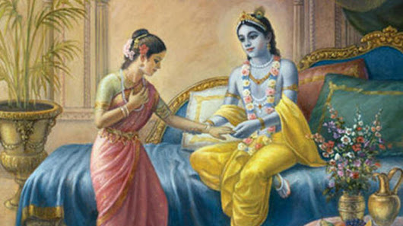
Thank you !
By Medhavini Sakhi Devi Dasi
13 May 2022
on the auspicious occasion of
Rukmini Dwadashi

